Slide 1
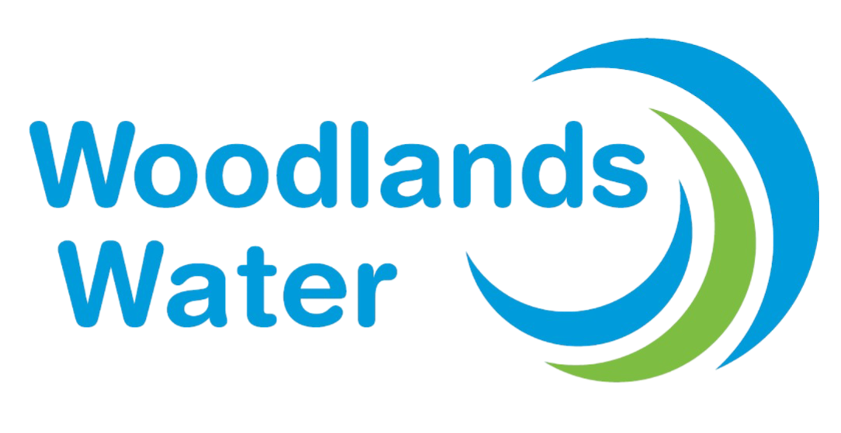
What is Water Renewal The Woodlands?
Collaborative effort by Woodlands Water, MUDs and SJRA
Focused on:
Long-term modernization and rehabilitation of water and wastewater infrastructure
Public education, involvement and transparency
Current and future potential project sources:
SJRA’s 10-year project plan (updated annually)
Woodlands Water’s 10-year project plan (in development)
Objective:
Transparency and education
Ensure efficient, reliable water and wastewater services
Maintain infrastructure soundness for decades to come
Notes:
Talking Points:
What It Is
Water Renewal The Woodlands is a collaborative effort between Woodlands Water, the Municipal Utility Districts (MUDs), and the San Jacinto River Authority (SJRA). It’s focused on ensuring our water and wastewater systems remain efficient, reliable, and sustainable as the community grows and ages.
What It Focuses On
Modernization and rehabilitation of critical water infrastructure that’s been in place for decades.
Promoting transparency, public education, and involvement so customers understand how these systems work and why long-term planning matters.
Where Projects Come From
Infrastructure needs are identified through:
SJRA’s 10-year project plan, which is reviewed and updated annually.
Woodlands Water’s 10-year project plan, which is currently in development to provide additional long-term clarity.
Why It Matters
These efforts help prevent future system failures, reduce costly emergency repairs, and maintain water quality and service reliability.
It’s about being proactive, not reactive, when it comes to essential infrastructure that affects every household and business.
The Goal
The overall objective is to educate and inform the public, so they are aware of and engaged in the water infrastructure decisions that will impact them now and into the future.

Slide 2
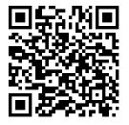
Get Involved
🔗 Visit www.waterrenewalthewoodlands.com
📨 Sign up for updates, explore project summaries, and share your feedback
Questions? Scan the QR Code!
Notes:
Talking Points:
Stay connected and get involved with the latest Water Renewal news via a dedicated email address, contact form and newsletter found on the Water
Renewal’s official website: www.waterrenewalthewoodlands.com.
Visit the website by scanning the QR code to sign-up for the email list, submit a question, or view information about ongoing and future Water Renewal
Projects.
The Water Renewal The Woodlands Initiative project team encourages public interested and involvement in this important initiative.

